Slide 1
Human resources slide 1
HUMAN RESOURCES ANALYTICS DASHBOARD
SUBMITTED BY HISAN-K

Slide 2
Human resources slide 2
INTRODUCTION
Human Resource Analytics helps organizations understand employee behavior using data.
Employee attrition is a major challenge affecting productivity and cost
This project analyzes HR data to identify attrition trends, employee distribution, satisfaction levels, and income patterns.
The dashboard provides interactive insights to support HR decision-making

Slide 3
Human resources slide 4
OBJECTIVES
ACTIONABLE INSIGHTS:
EMPLOYEE ATTRITION RATE:
To provide actionable insights for HR strategy improvement
To analyze employee attrition rate across departments, age groups, and gender
MONTHLY INCOME:
HIGH ATTRITION RISK:
To understand monthly income distribution by job role.
To identify departments with high attrition risk
HUMAN RESOURCES

Slide 4
Human resources slide 5
TAKEN FROM KAGGLE
DATASET OVERVIEW
The dataset contains comprehensive Human Resource (HR) employee information.
Each record represents one individual employee in the organization.
HR PLAN
32 COLUMNS
2845 RAWS
Total number of employees analyzed: 2,845.
The dataset includes both demographic and job-related attributes

Slide 5
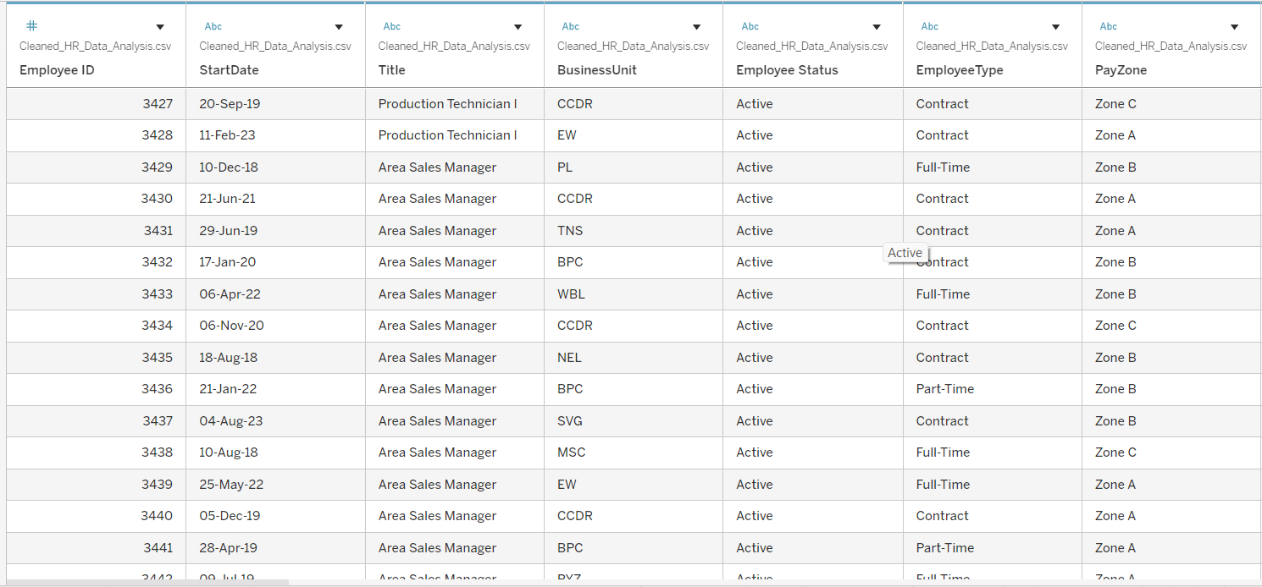
Human resources slide 6
DATA SET

Slide 6

Human resources slide 8
DATA CLEANING AND PREPARATION
Removed duplicate employee records.
Checked and handled missing or null values.
Converted categorical fields (Attrition, Gender) into readable formats.
Created calculated fields:
Attrition Rate
Attrition Count
Created age bins for age group analysis.
Ensured correct data types for numerical and categorical columns.

Slide 7

Human resources slide 7
TOOLS AND TECHNOLOGIES USED
KAGGLE
EXCEL
TABLEAU
POWER
POINT
DATA VISUALIZATION
AGGREGATIONS AND
FILTERS
CALCULATED FIELDS
INTERACTIVE DASHBOARD

Slide 8
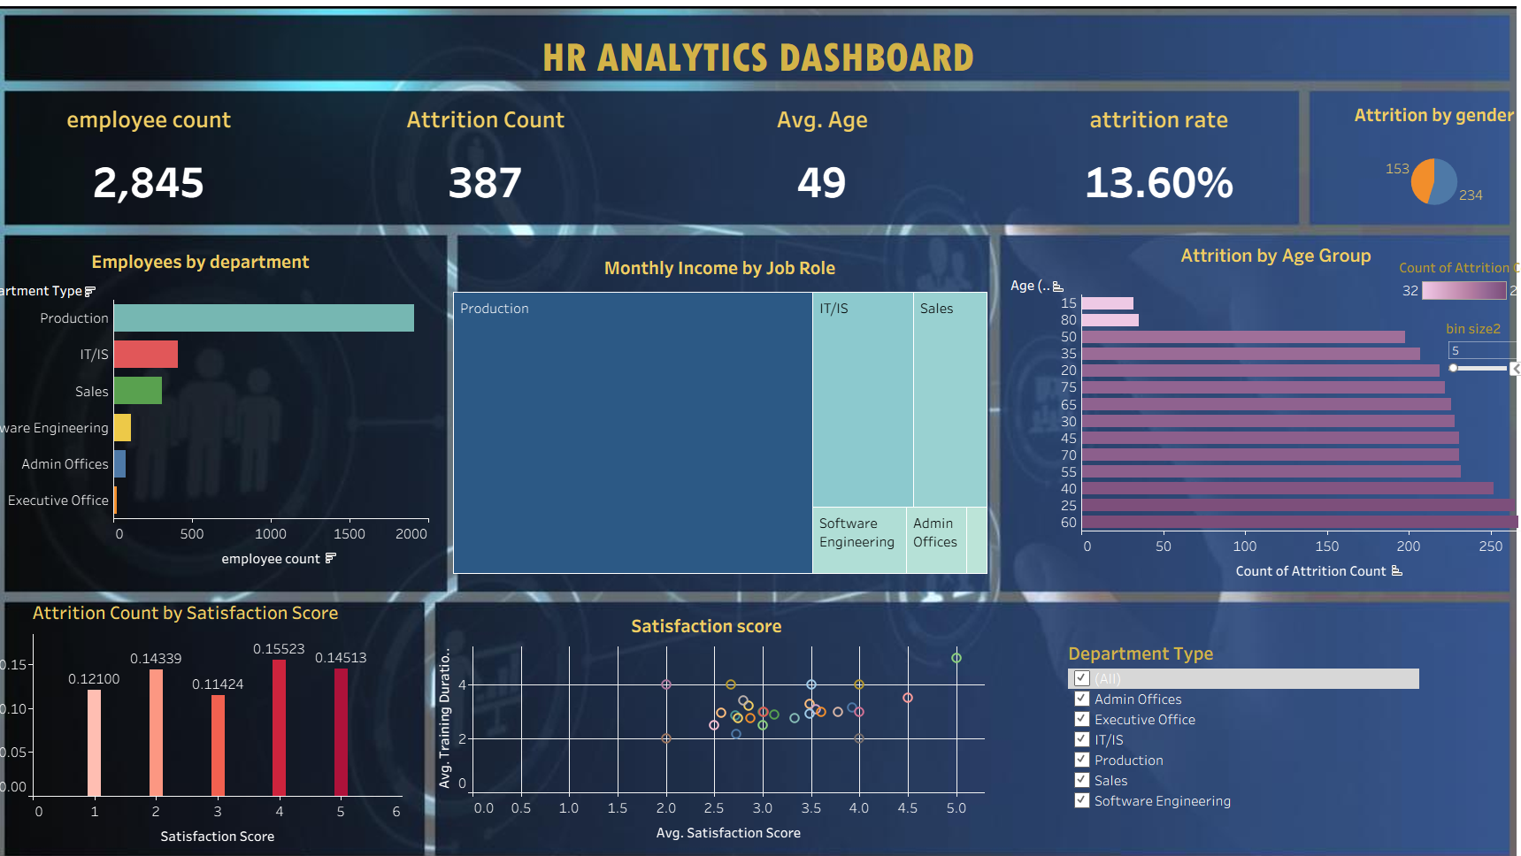
Human resources slide 8

Slide 9
Human resources slide 8
DASHBOARD SUMMARY
Total Employees: 2,845
Attrition Count: 387
Income varies significantly across job roles
Attrition Rate: 13.60%
Average Employee Age: 49 years
Production department has the highest employee count.

Slide 10
Human resources slide 11
KEY INSIGHTS
Insight 1: Department-wise Analysis
Production department has the highest number of employees.
IT/IS and Sales show moderate employee strength.
Insight 2: Attrition by Gender
Attrition is higher among male employees compared to female employees.
Insight 3: Attrition by Age Group
Higher attrition observed in mid-age groups (25–40).
Lower attrition among very young and senior employees
Insight 4: Satisfaction Score
Employees with lower satisfaction scores show higher attrition.
Attrition decreases as satisfaction score increases.
Insight 5: Monthly Income
Production and IT roles contribute most to total income.
Admin and Software Engineering roles have comparatively lower income contribution.

Slide 11
Human resources slide 11
CONCLUSION
Attrition rate of 13.6% indicates a need for focused HR strategies.
Employee satisfaction plays a key role in retention.
Departments with high attrition need targeted engagement programs.
The dashboard enables data-driven HR decision-making.

Slide 12
Human resources slide 10
Thank You

